Slide 1
Group 2 Project
Fruits Vending Membership System
Zou Xuan (E0384799)
Xu Jiao (E0384412)

Slide 2
Agenda
Overview
Project Scope
Project Conduct
Security Requirements
Threat Model
Security Architecture
Verification of Security Controls
Demonstration

Slide 3

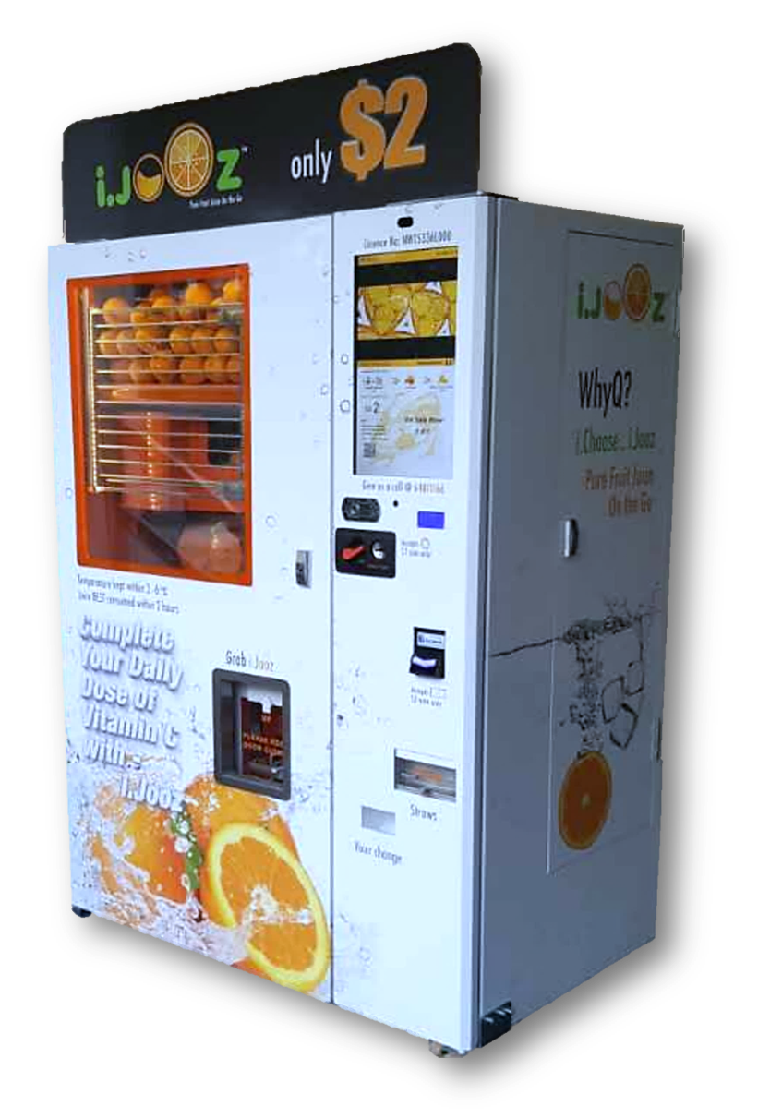
Overview
Fruits vending membership system is used by Fruits Vending Pte Ltd to interact with their customers via selling QR code online.
However, current system is failed to address below security/business requirements.
Mobile App
2FA while signing up
Reset password
Login with social media account
Auth configuration and operational data persistency
Token refreshment and revocation
Privilege restriction for data update
Sensitive data encryption

Slide 4
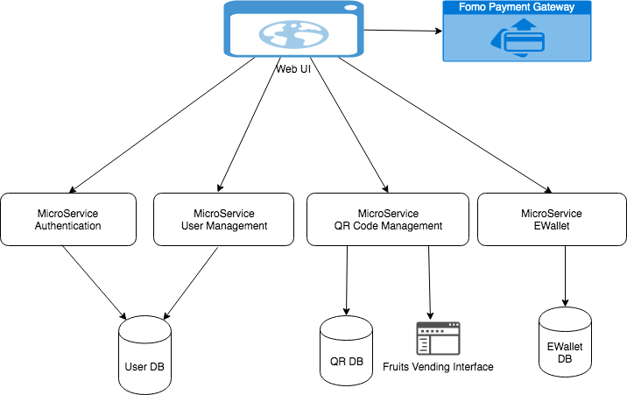
Overview – Architecture Old

Slide 5
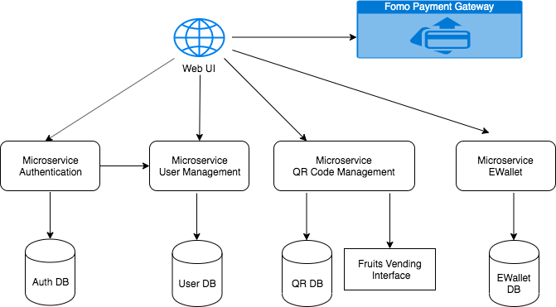
Overview – Architecture New

Slide 6
Project Scope
1. Build an application that can run as native application in Android/ios devices as well as a Progressive Web application.
2. Add 2FA to new user creation and reset password function.
3. Login with Facebook
4. Store authentication configuration and operational data in Database instead of in memory.
5. Refresh and revoke token
6. Get user info from token instead of data payload.
7. Sensitive data (including database and config file) encryption
7. Verify token with Auth service instead of verify locally and adding caching mechanism.(This is to reduce impact when auth server change certificate)
8. Verify signature for fomo payment.

Slide 7
Project Conduct
Task | Efforts | Team member
2FA in user management service | 2 days | Xu Jiao
Forget password in user management service | 1 day | Xu Jiao
Login user validation API in user management service | 1 day | Xu Jiao
Generate signed apk | 0.5 day | Xu Jiao
Implement email notification | 2 days | Xu Jiao
Enable https for user service | 2 days | Xu Jiao
Sensitive data encryption | 1 day | Xu Jiao
Store configurable data and token in DB instead of in memory. | 1 day | Zou Xuan
Read user info from token instead of payload in E-Wallet service | 0.5 day | Zou Xuan
Build Mobile/ Web UI and integrate with backend services | 9 days | Zou Xuan 5 days/ Xu Jiao 4 days
Implement fomo payment | 2 days | Zou Xuan
Integrate login with Facebook (including exchange jwt token with Auth service) | 3 days | Zou Xuan
Refresh token, revoke token. Verify token viaAuth service instead of locally and add caching mechanism. | 2 days | Zou Xuan
Deploy website to Google Firebase and other APIs to google cloud | 1 day | Zou Xuan
Fortify SCA code scan and OWASP ZAP report | 0.5 day | Zou Xuan

Slide 8
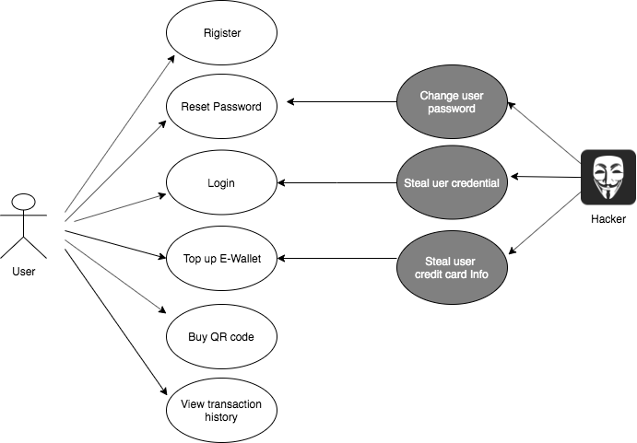
Security Requirements-1

Slide 9
Security Requirements-2
Requirement Category | Requirement description
Authentication Requirements | Integrate Facebook with OpenID Connect protocol, 2FA for register and reset password
Authorization Requirements | User is not allowed to access unauthorized page by directly copy url. Backend services validate JWT token signature/scope/expiry before returning response.
Integrity Requirements | Generate and verify signature with apiKey for fomo payment.
Availability Requirements | Deployed to cloud and enable auto scale & HA when traffic grows.
Accountability Requirements | Add transaction history and server log for traceability.
Exception Handling Requirements | Provide general error message when exception occurred.
Confidentiality Requirements | Store apiKey and client secrets in server environment variables without passing through internet. All the services communicate through https. Sensitive data encryption
Session Management Requirements | Keep token timeout in 1 hour , auto refresh before expiry. Remove token from local storage and revoke refresh token when logoff.

Slide 10
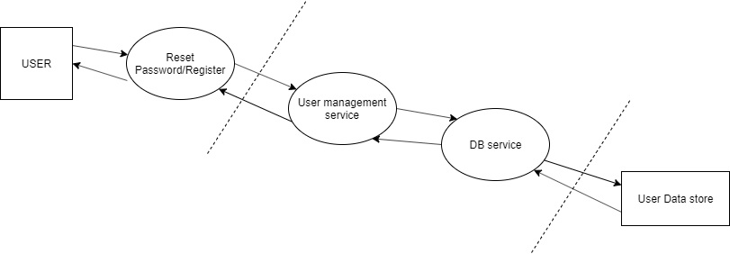
Threat Modelling-1 Decompose the Application
Use Case 1-Register/Reset Password

Slide 11
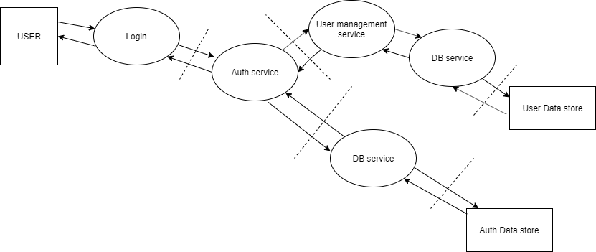
Threat Modelling-1 Decompose the Application
Use Case 2 - Login

Slide 12
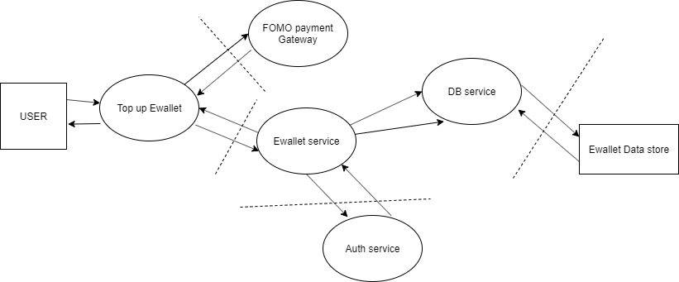
Threat Modelling-1 Decompose the Application
Use Case 3- Top up E-Wallet

Slide 13
Threat Modelling -2 Identity Threats
Data Flow Element | Threat Category | Identified Threat | Threat
User | Spoofing | Broken Authentication | Attacker impersonate other users to reset password/login.
Fomo payment gateway/E-Wallet service | Spoofing | Broken Authentication | Attacker impersonate other users to do payment/Top up E-Wallet.
All Use case data flow | Spoofing | Man-in-the-Middle | Attacker may alter the information to the server
All Service | Tempering | Cross Site Request forgery | Attacker may change the user information.
All Service | Elevation of privilege | Logic Flaw | Developer may use hardcode the program for testing which results in user making unauthorised request.
All Services | Denial of services | Accepting Large Volume | Attacker supply high volume of data which server can’t handle the load.
All Services | Information Disclosure | Verbose Exception | Server response includes error information to user which reflects internal file structure or stack trace information.
All Services | Repudiation | Audit Log lacking | Attacker may modify user data without tracking
All Data Store | Repudiation | Audit Log Deletion | Attacker may use SQL statement to delete the log data store.
All Data Store | Tampering | SQL Injection | Attacker may use SQL statement in the input fields in order to do the damages on the database.

Slide 14
Threat Modelling -3 Prioritize Threats
S/N | Identified Threat | Asset | Probability |  |  | Impact |  | Risk Level (P*I)
 |  |  | DI | R | E | A | D
1 | Man-in-the-Middle | User Info, E-Wallet Info, QR Info | 2 | 3 | 1 | 3 | 2 | 30
2 | Verbose Exception | System Info, Database Info | 1 | 1 | 2 | 3 | 2 | 20
3 | SQL Injection | All Database Tables | 3 | 3 | 3 | 2 | 2 | 36
4 | Cross Site Request Forgery | User Credential, E-Wallet balance | 2 | 2 | 3 | 2 | 2 | 28
5 | Audit Log Lacking | Traceability | 1 | 1 | 1 | 3 | 1 | 12
6 | Logic Flaw | System | 1 | 1 | 1 | 2 | 1 | 9
7 | Audit Log Deletion | Traceability | 3 | 0 | 0 | 1 | 1 | 6
8 | Broken Authentication | User Info, E-Wallet Info, QR Info | 2 | 3 | 3 | 2 | 2 | 32
9 | Accepting Large Volume | System Functionality | 3 | 2 | 2 | 3 | 1 | 28

Slide 15
Threat Modelling -4 Identity Controls
S/N | Identified Threat | Risk Level | Risk Ranking | Mitigation Control | System Traceability (Use Case)
3 | SQL Injection | 36 | 1 | Use ORM to access database | All
8 | Broken Authentication | 32 | 2 | Verify jwt token signature/scope/expiry before returning server data. | Login Top up E-wallet Buy QR code.
1 | Man-in-the-Middle | 30 | 3 | Use HTTPS connection with TLS 1.2 | All
9 | Accept-Large-Volume | 28 | 4 | Use client side input validation. Use maxAllowed content length. Use excution timeout. | All
4 | Cross Site Request Forgery | 28 | 4 | Remove session Whitelist CORS | All
2 | Verbose Exception | 20 | 5 | Use general error message | All

Slide 16
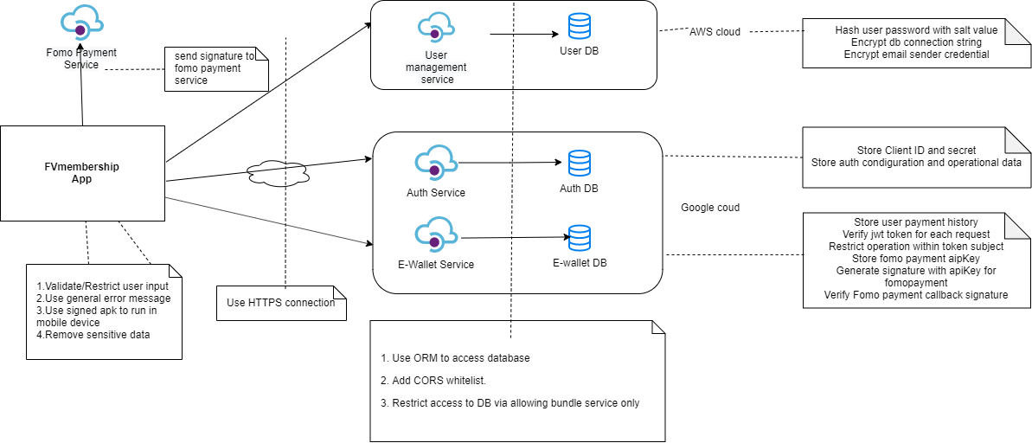
Security Architecture

Slide 17
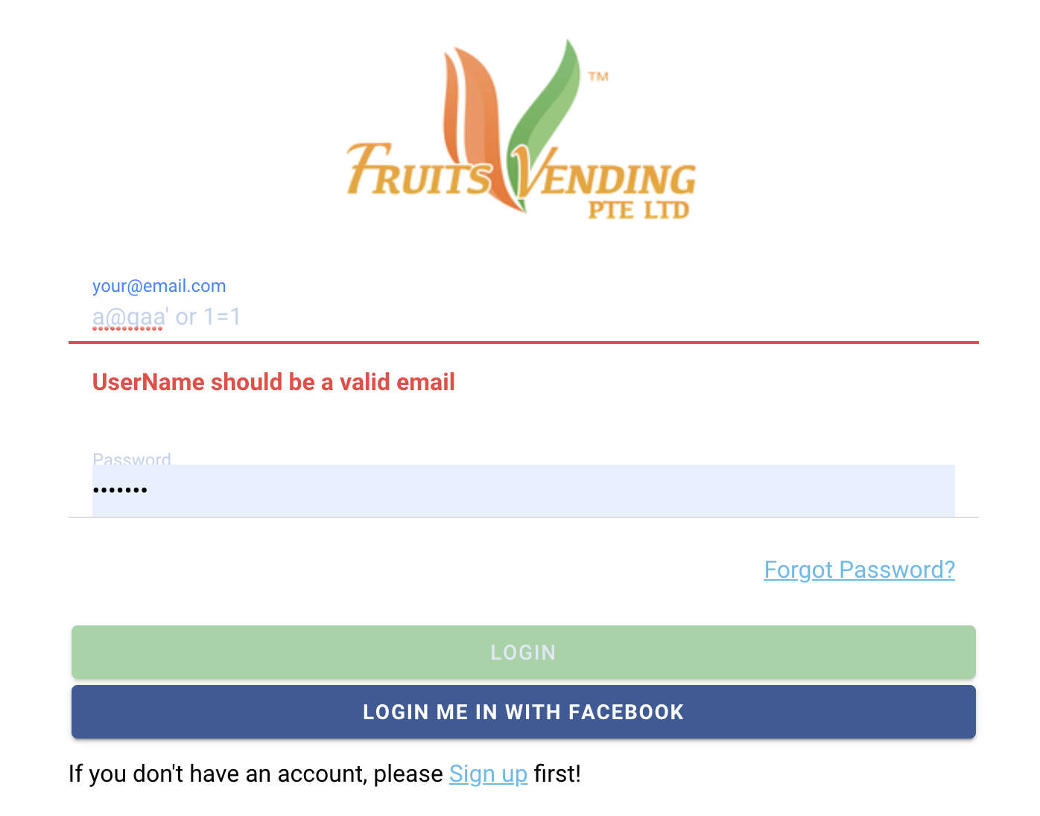
Verification of Security Controls - 1 SQL Injection

Slide 18
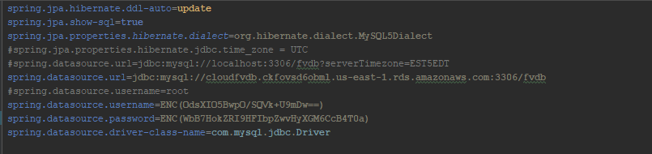
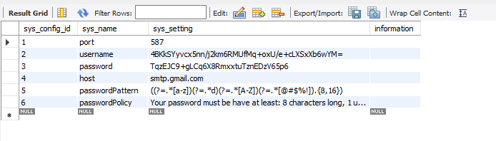

Verification of Security Controls - 2 Encryption of sensitive data

Slide 19
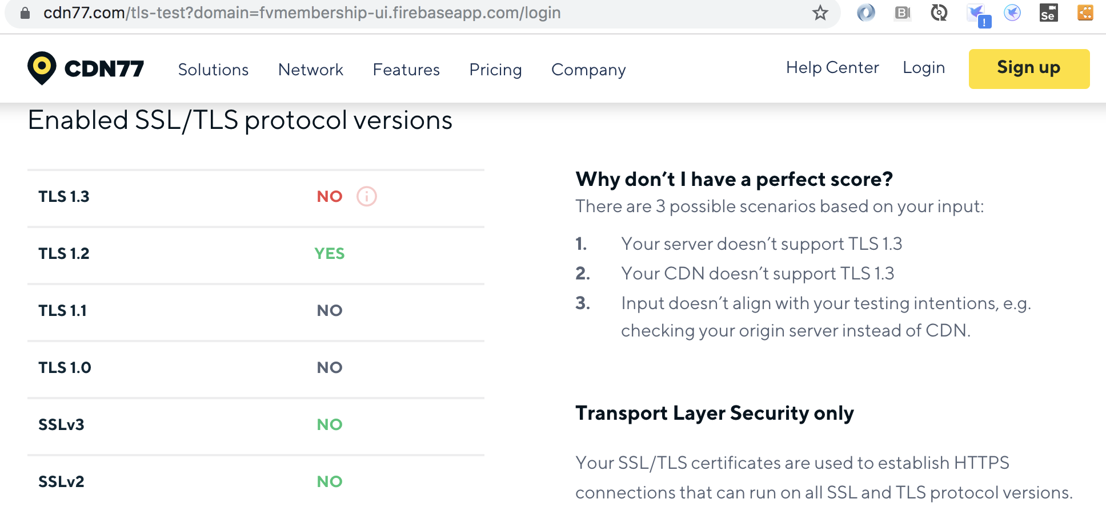
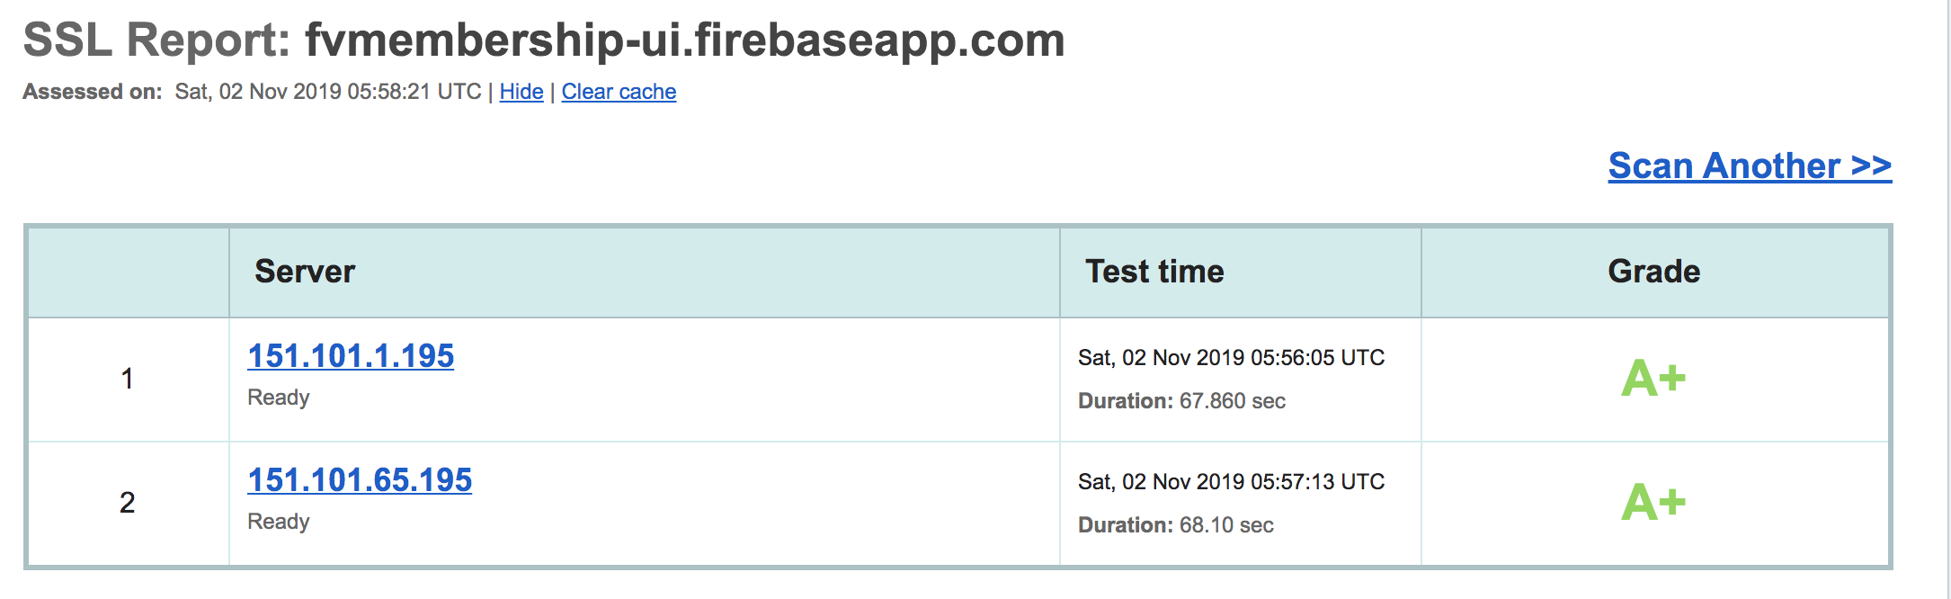
Verification of Security Controls - 3 Man-in-the-middle
Enabled SSL/TLS protocol versions

Slide 20
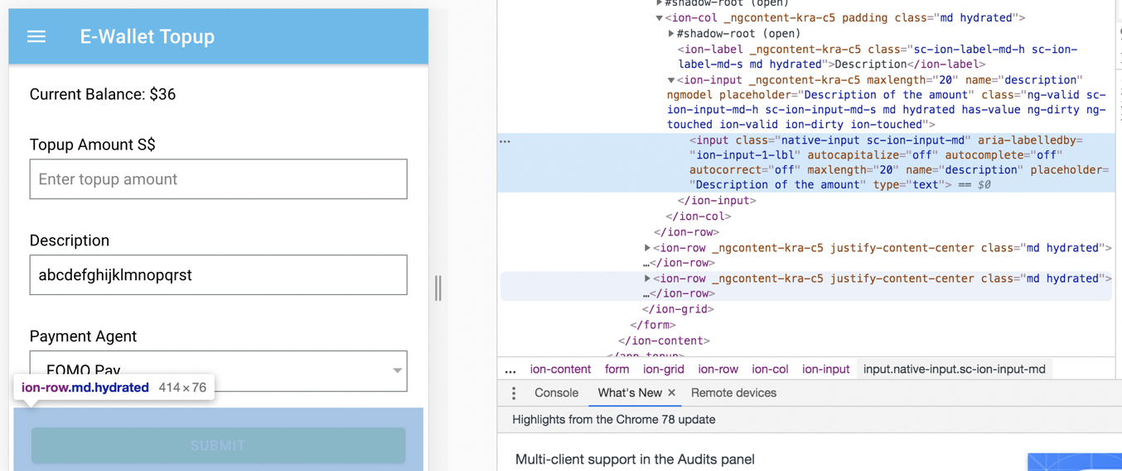
Verification of Security Controls - 4 Accepting Large Volume

Slide 21
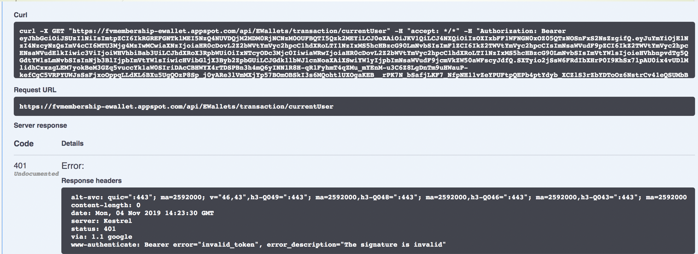
Verification of Security Controls - 5 Broken Authentication

Slide 22
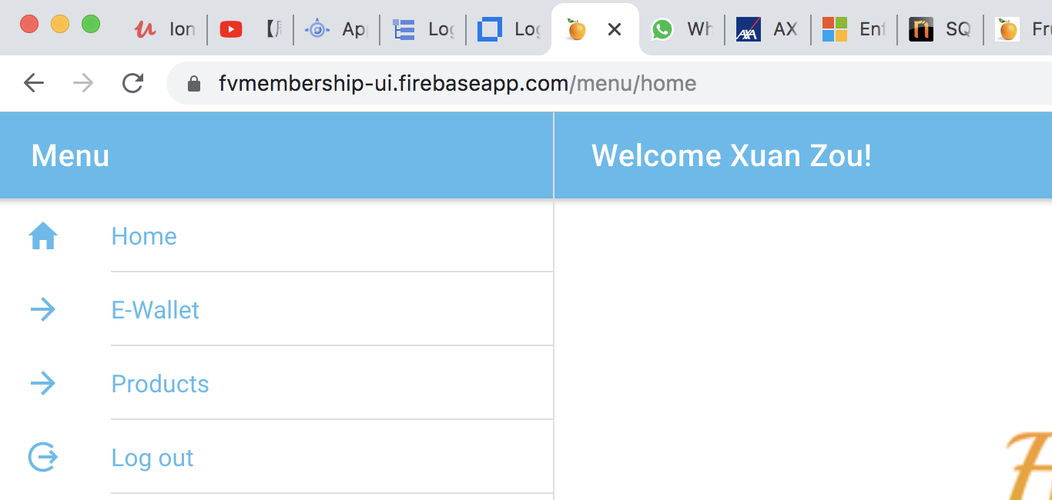
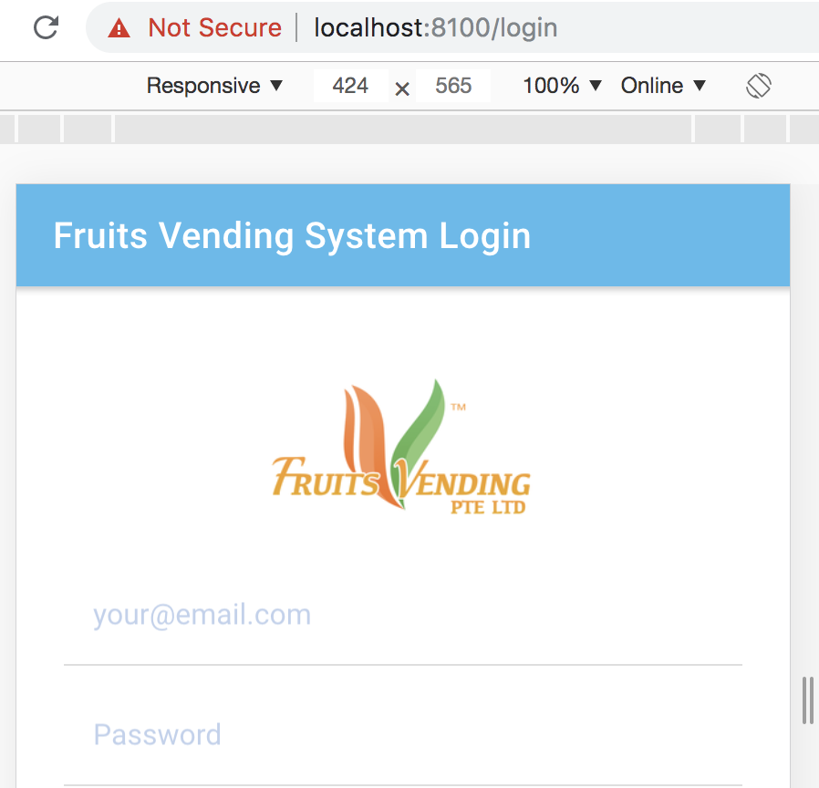
Verification of Security Controls - 6 Cross Site Request Forgery -- No Session -- localStorage data is bind to domain -- i.e localhost cannot access fvmembership-ui localStorage

Slide 23
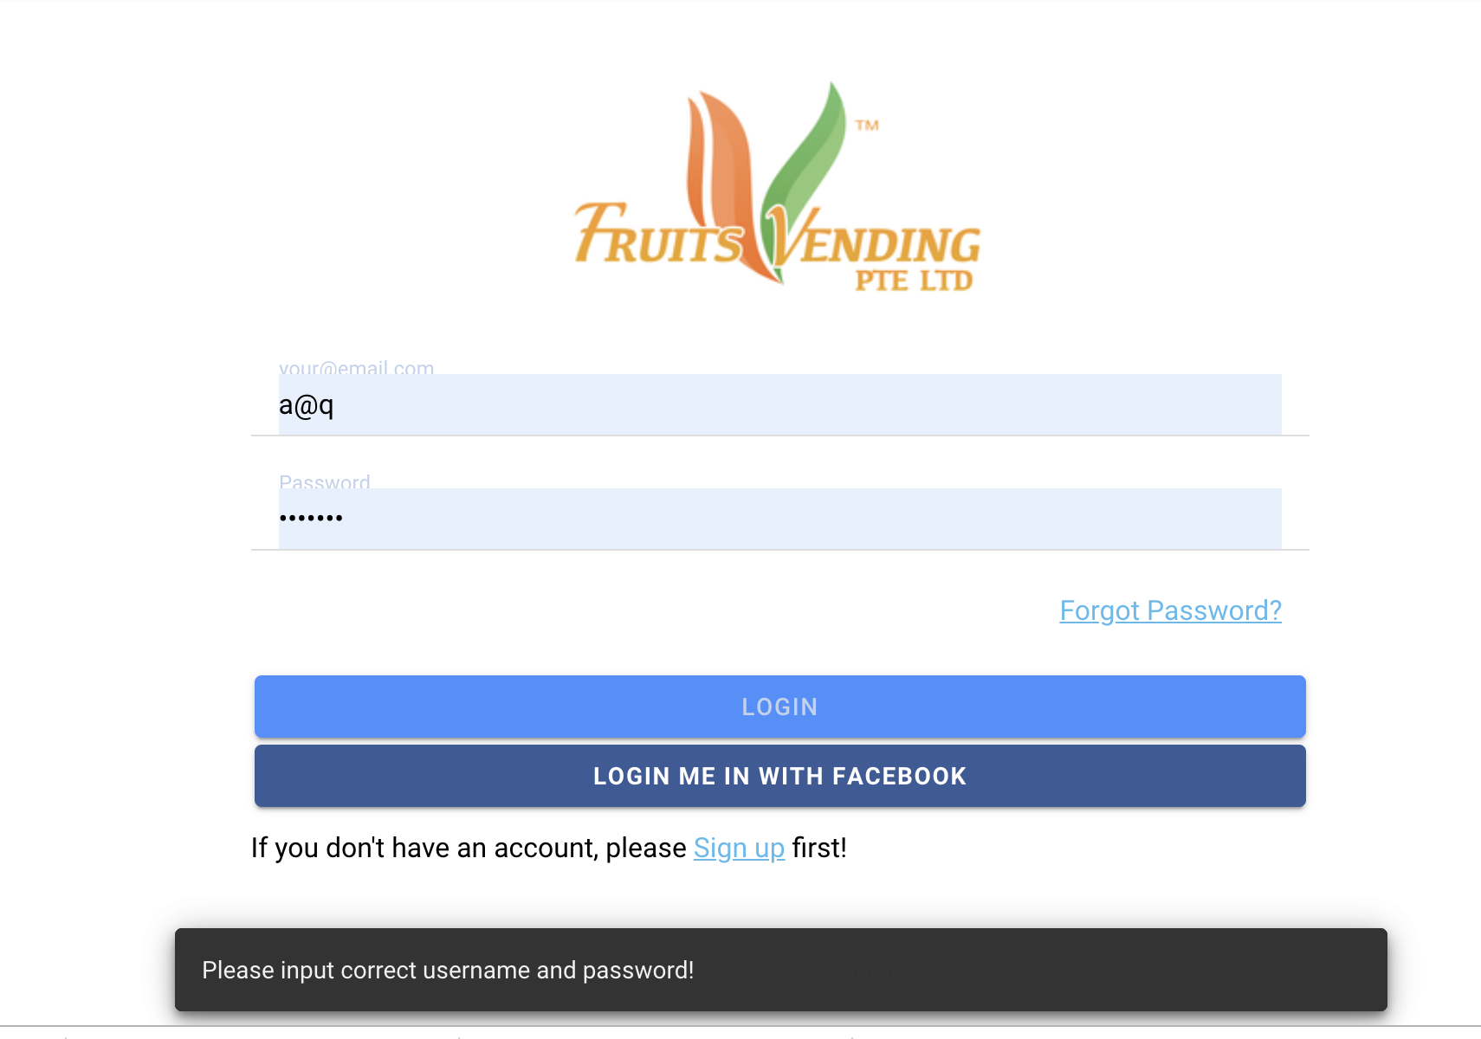
Verification of Security Controls - 7 Verbose Exception

Slide 24
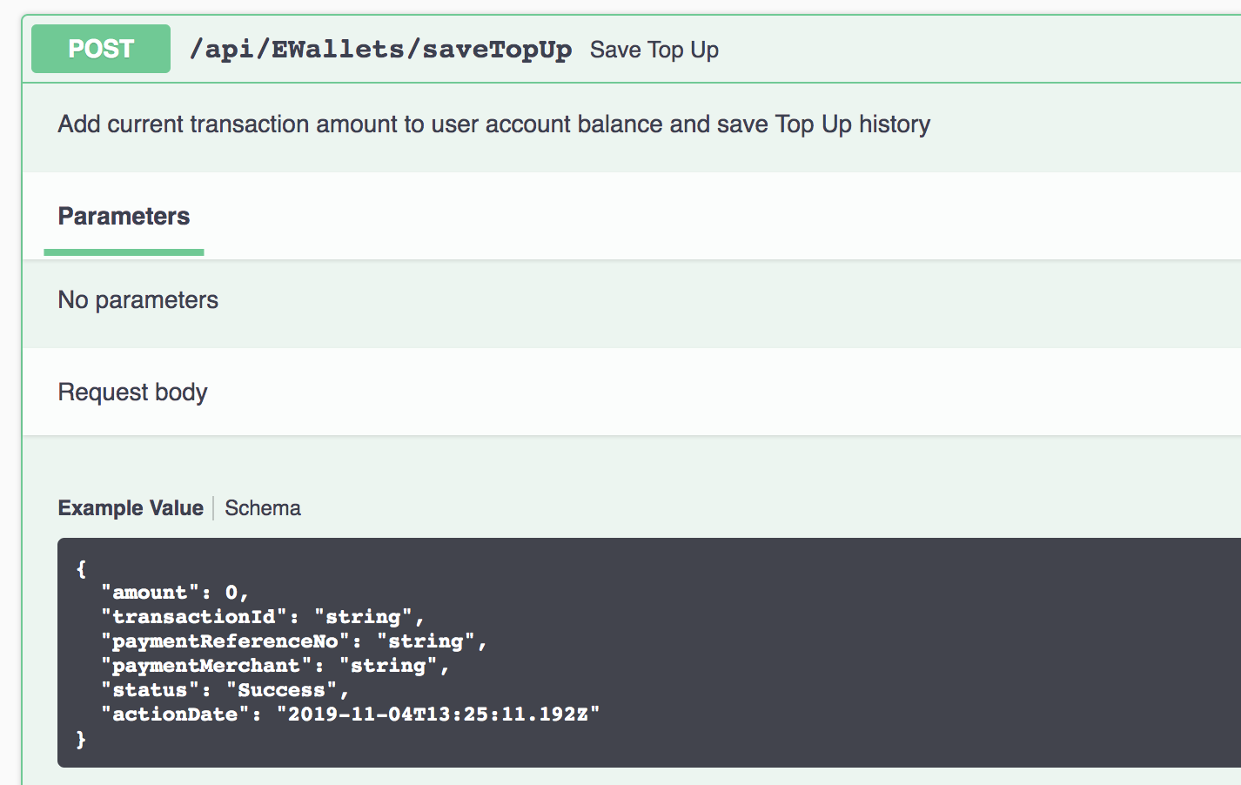
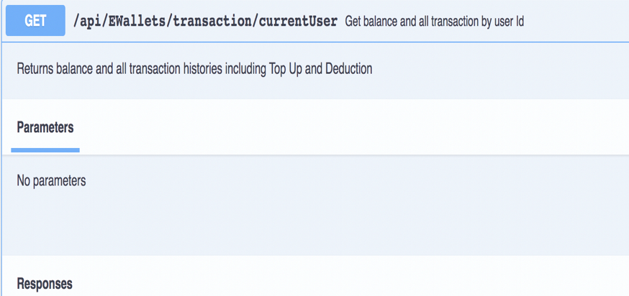
Verification of Security Controls - 8 Lease Privilege --No User Id in payload

Slide 25
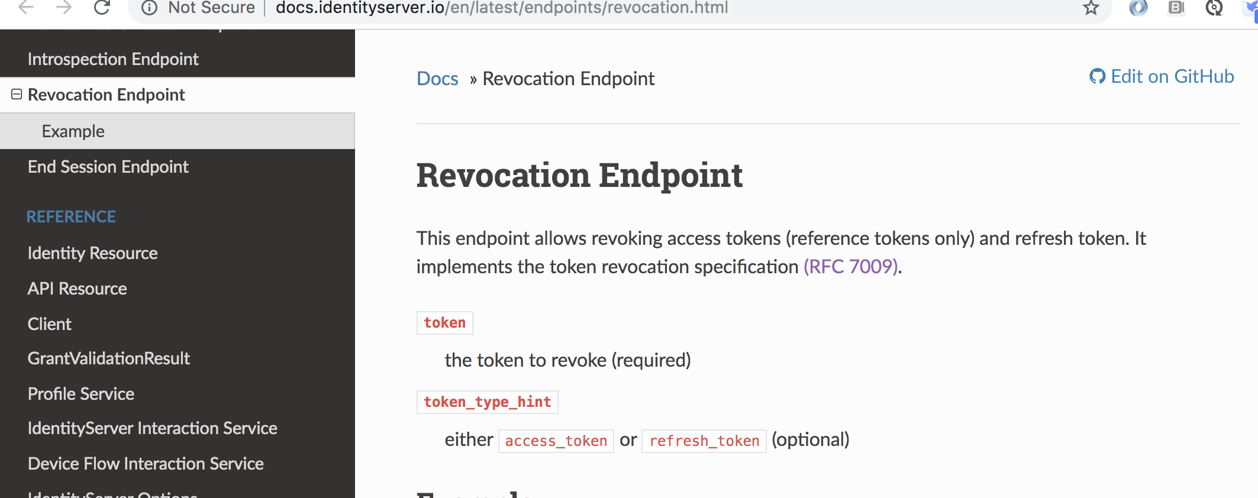
Verification of Security Controls - 9 Token Revocation

Slide 26
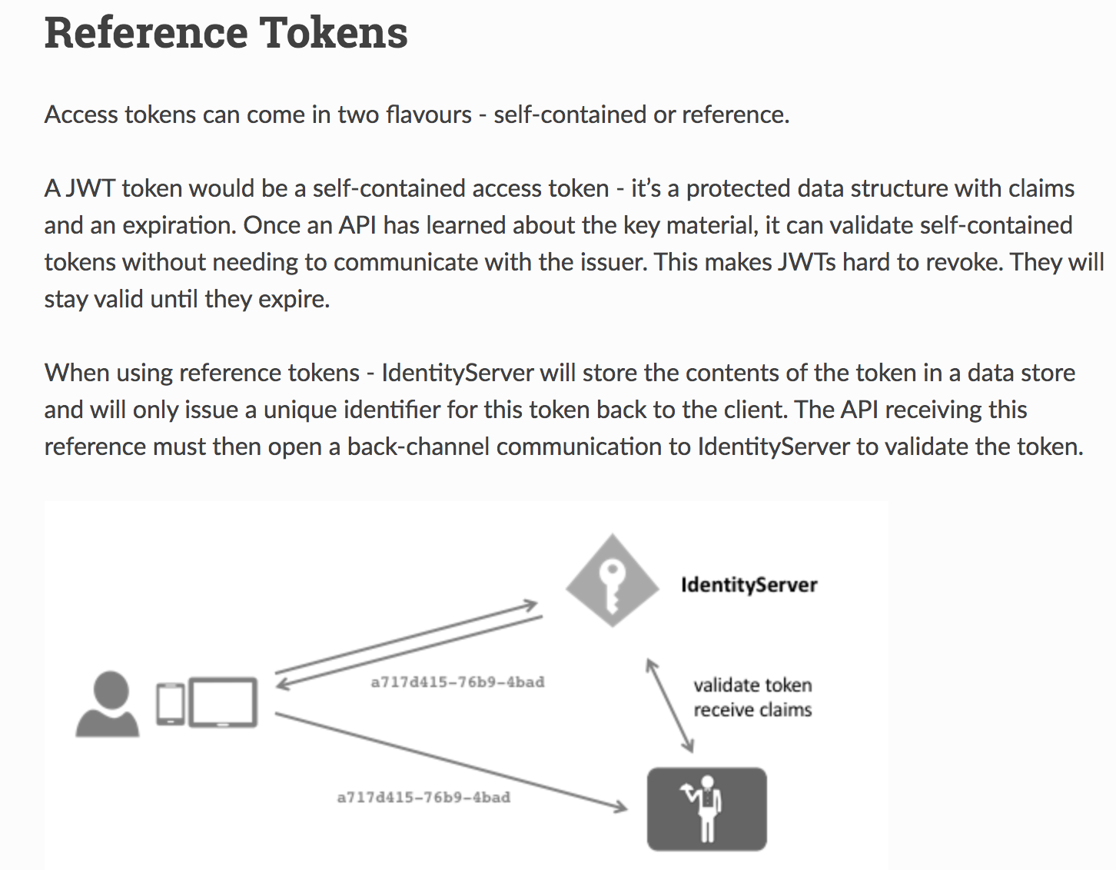
Verification of Security Controls - 10 Token Revocation

Slide 27
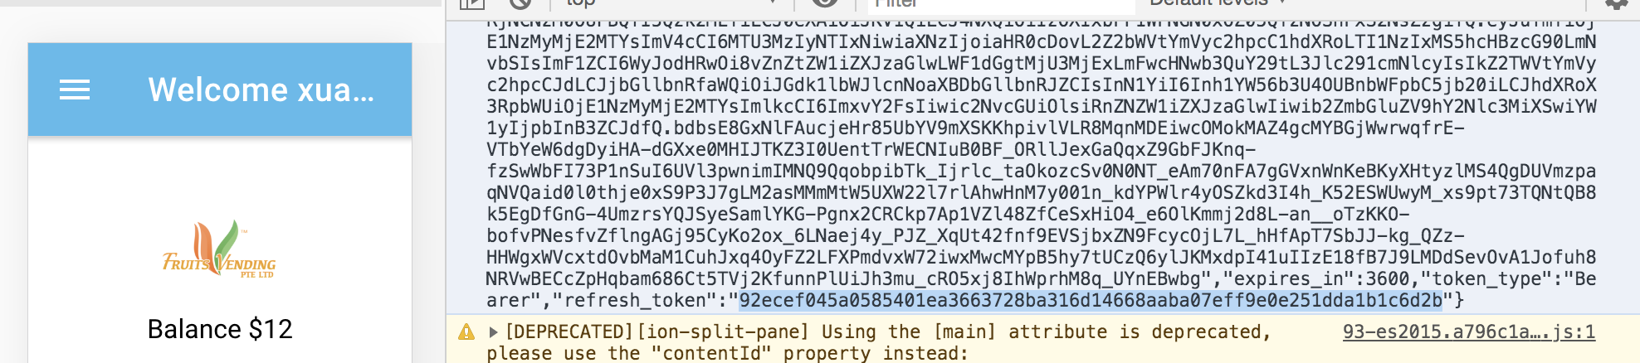
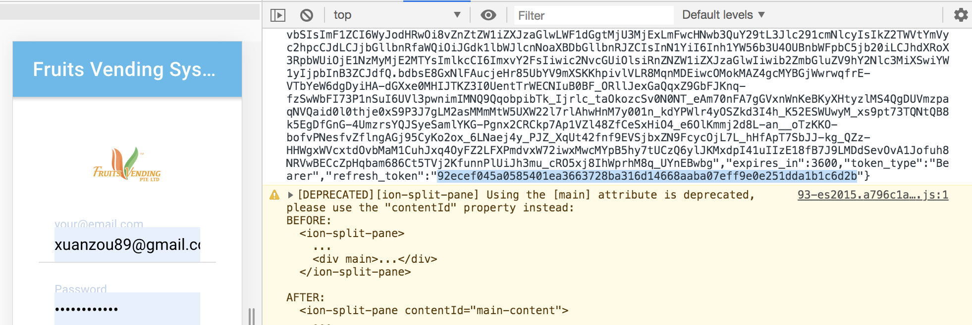
Verification of Security Controls - 11 Token Revocation -a
Login
Logout

Slide 28
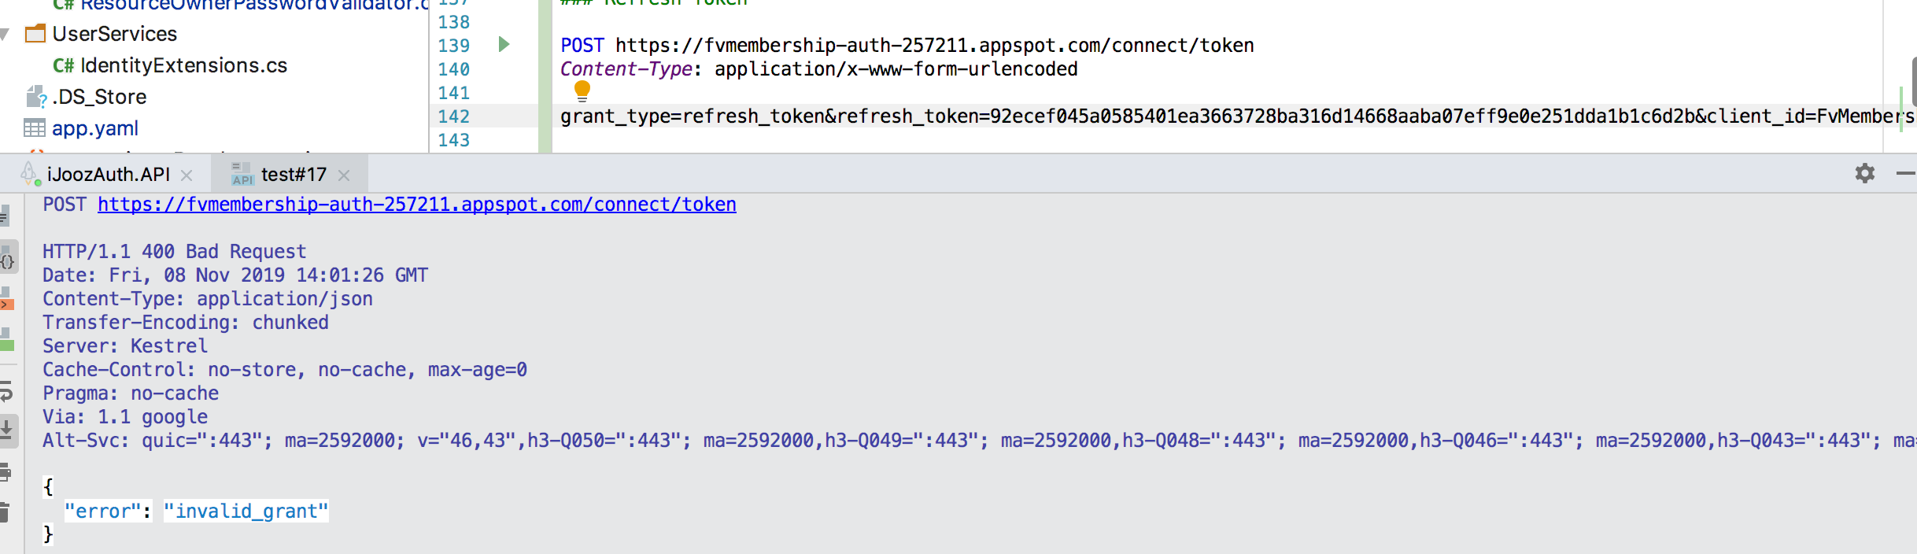
Verification of Security Controls - 11 Token Revocation -b
The refresh token does not work anymore

Slide 29
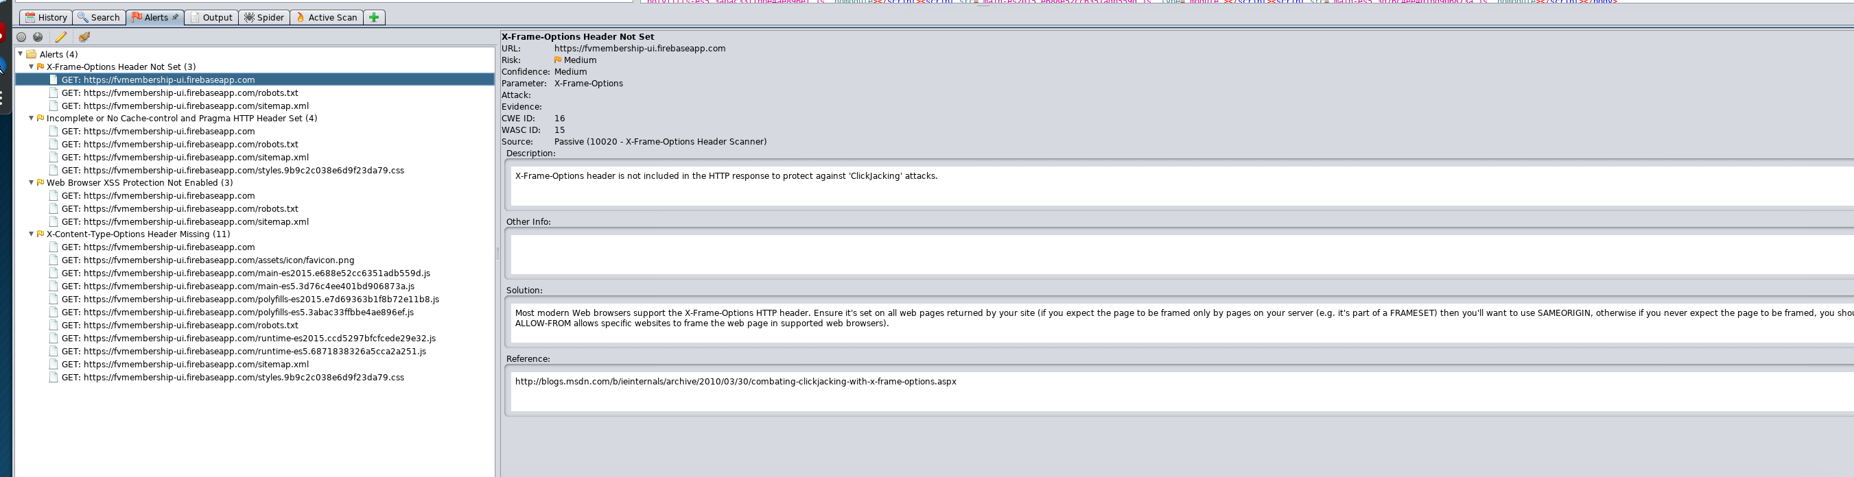
Verification of Security Controls – 12 Others – ZAP Report
--Only Medium and low risk found
--Risk found is from ionic framework

Slide 30
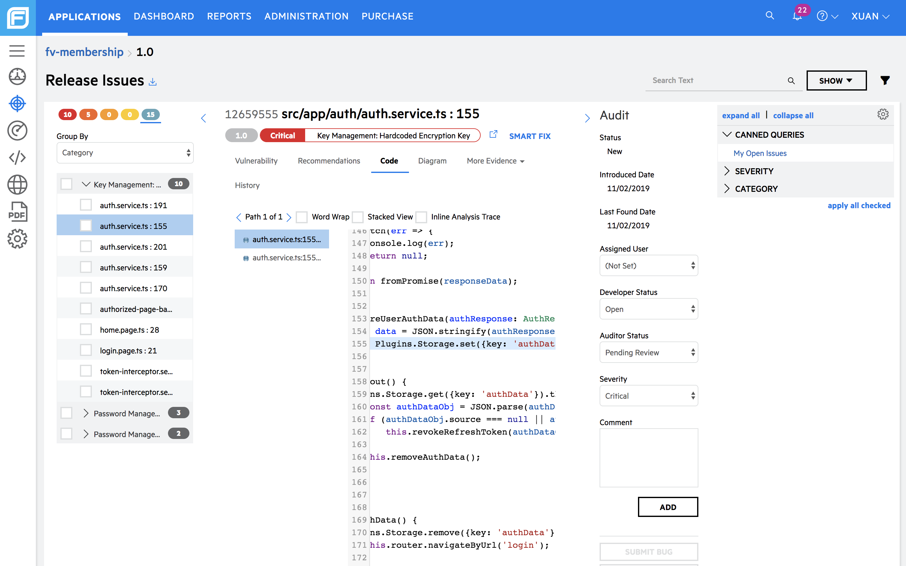
Verification of Security Controls – 13 Others – Fortify SCA scan -UI
--All are false alert
--The key highlighted below is Plugins.Storage key value syntax

Slide 31
Demo

